Slide 1
Sorting Quizzes
Bubble Sort
Selection Sort
Insertion Sort
Merge Sort

Slide 2
Bubble Sort(거품 정렬) Exercise
It compares every adjacent pair, swap their position if they are not in the right order (the latter one is smaller than the former one). After each iteration, one less element (the last one) is needed to be compared until there are no more elements left to be compared.
54
26
93
17
77
31
44
55
20
List to sort
26
54
17
77
31
44
55
20
93
PASS 1 (8 Comp, 7 Swap)
27
17
54
31
44
55
20
77
PASS 2 (7 Comp, 5 Swap)
PASS 3 ( Comp, Swap)
PASS 4 ( Comp, Swap)
PASS 5 ( Comp, Swap)
PASS 6 ( Comp, Swap)
17
20
26
PASS 7 (2 Comp, 1 Swap)
17
20
PASS 8 (1 Comp, 0 Swap)
Total PASS 8 (36 Comp, 5 Swap)

Slide 3
Selection Sort(선택 정렬) Exercise
54
26
93
17
77
31
44
55
20
List to sort
54
26
20
17
77
31
44
55
93
PASS 1 ( 8 Comp, 1 Swap)
PASS 2 ( Comp, Swap)
PASS 3 ( Comp, Swap)
PASS 4 ( Comp, Swap)
PASS 5 ( Comp, Swap)
PASS 6 ( Comp, Swap)
PASS 7 ( Comp, Swap)
17
20
26
31
44
54
55
77
93
PASS 8 ( Comp, Swap)
Total PASS 8 (36 Comp, 5 Swap)

Slide 4
Insertion Sort(삽입 정렬) Exercise
54
26
93
17
77
31
44
55
20
List to sort
pick 26 & inserted
26
54
93
17
77
PASS 1 (1 Comp, 1 Shift)
pick 93 & inserted
26
54
93
17
77
PASS 2 (1 Comp, 0 Shift)
pick 17 & inserted
17
26
54
93
77
PASS 3 (3 Comp, 3 Shift)
pick 77 & inserted
PASS 4 ( Comp, Shift)
pick 31 & inserted
PASS 5 ( Comp, Shift)
pick 44 & inserted
PASS 6 ( Comp, Shift)
pick 55 & inserted
17
26
31
44
54
55
77
93
20
PASS 7 (3 Comp, 2 Shift)
pick 20 & inserted
17
20
26
31
44
54
55
77
93
PASS 8 (8 Comp, 7 Shift)
Total PASS 8 (26 Comp, 20 Shift)

Slide 5
Mergesort Quiz
Improvement by reducing the number of merge() function call. Some hints for this problem are provided in the following two pages.
How many times did you spare merge() calls for "MERGESORTEXAMPLE" case?
Total number of merge() calls without your improvement: ______________
The number of merge() calls spared with your improvement: ________________
Identify those sets of char array groups that merge() call was unnecessary.

Slide 6
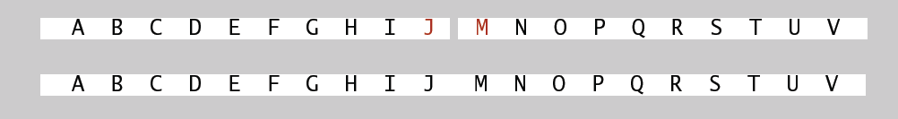
Mergesort Quiz
Hint: Do not invoke "merge()" function if two halves are already sorted..
Is the biggest item in first half ≤ the smallest item in second half?
For example, the following case should not call merge() since J <= M.
정렬들에 관한 좋은 자료를 읽어 보길 적극 추천합니다.
영어: https://medium.com/basecs/making-sense-of-merge-sort-part-1-49649a143478
한글: https://gmlwjd9405.github.io/2018/05/08/algorithm-merge-sort.html

Slide 7
Mergesort Quiz
Hint: Do not invoke "merge()" function if two halves are already sorted..
Is the biggest item in first half ≤ the smallest item in second half?
For example, the following case should not call merge() since J <= M.
void mergeSort(char *a, char *aux, int N, int lo, int hi) {
if (hi <= lo) return;
int mi = lo + (hi - lo) / 2;
mergeSort(a, aux, N, lo, mi);
mergeSort(a, aux, N, mi + 1, hi);
// your code here // already sorted
merge(a, aux, lo, mi, hi);
}

Slide 8
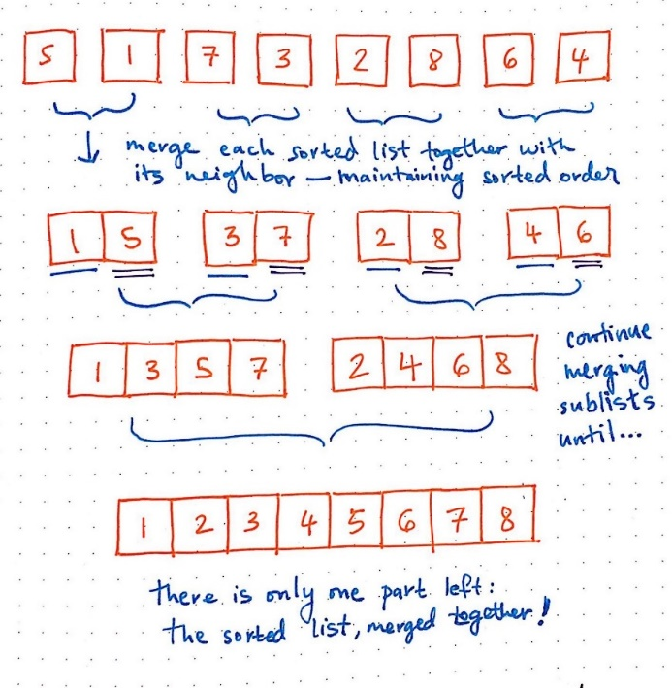
Mergesort: Quiz 2
In the figure, which elements are compared in isSorted() at postcondition?
Explain why it is enough to check only two elements as postcondition? You may use the figure elements to explain the case.
int isSorted(int *a, int i, int j){return a[i] <= a[j];}
void merge(int *a, char *aux, int lo, int mi, int hi) {
assert(isSorted(a, lo, mi)); // precondition: a[lo..mi] sorted
assert(isSorted(a, mi+1, hi)); // precondition: a[mi+1..hi] sorted
for (int k = lo; k <= hi; k++) aux[k] = a[k];
……
assert(isSorted(a, lo, hi)); // postcondition: a[lo..hi] sorted
}

Slide 9
Sorting Algorithm Animation
quicksort
Selection Sort
Merge sort
Bubble Sort
Insertion Sort
http://www-scf.usc.edu/~zhan468/public/Notes/sorting.html

Slide 10
C++ For C Coders 7
Bubble Sort
Selection Sort
Insertion Sort

